Slide 1
Milestone 2
DisCourse:
A flexible platform to talk about course selection
Team 14 | Hazel Dunn, Matthew Chandra, Nicole Pupp, Seraphina Yong, Kimney Nguyen
Notes:
We are Team 14, Our app is DisCourse, a flexible platform for talking about course selection.

Slide 2
Our App Idea
Create a course-reviewing platform that fulfills student needs.
Notes:
(~15 seconds) - Hazel
We came up with a platform that is centered around reviewing and sharing information about University of minnesota courses. Most currently existing platforms are more focused on professor-based reviews, while ours focuses on individual courses; allowing users to browse, rate and write reviews.

Slide 3
User Tasks
Create a profile so readers know more about where you’re coming from when they read your review.
Browse through reviewed classes if you’re still thinking about what classes to take.
Provide your opinion about others’ reviews by commenting or liking/disliking.
Write a review for a class using prompts that are designed to help you provide the information readers want to know.
Notes:
Matt ~25s
Our user tasks are:
- creating a profile to give context about the reviews they write.
- browsing through reviewed classes when they are yet to decide what classes to take,
- interacting with each individual reviews, specifically by commenting, liking or disliking.
- and writing a review of their own using prompts that are designed to help provide the information readers want to know.

Slide 4

Demo
Notes:
Next, we will demo the features of Discourse while highlighting the user tasks that were just mentioned.
Just to clarify, the badges we just showed in the profile are awards that the user gets for writing reviews
Next, we’ll go through the key design decisions that we made in creating the high-fidelity prototype.
So in our low-fidelity prototype, we originally directed the user to their profile after they finished creating it. However, during the cognitive walkthrough we realized that someone using this app would be more excited to start using the main features of the app instead of looking at the profile they just made, so we made the design change to route the user to the homepage instead, where they can directly see all the cool features and start using them.

Slide 5
Key Design
Decisions

Slide 6
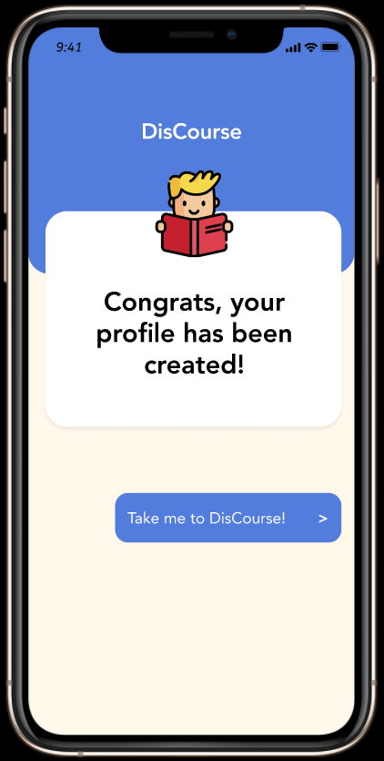
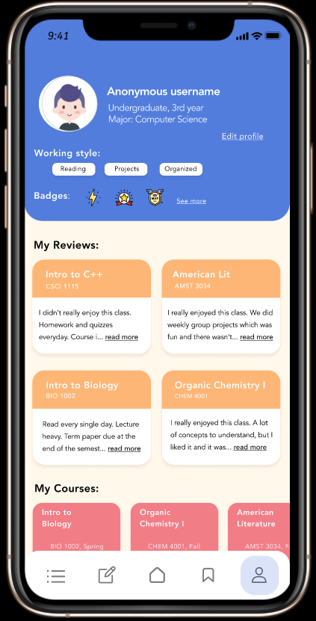
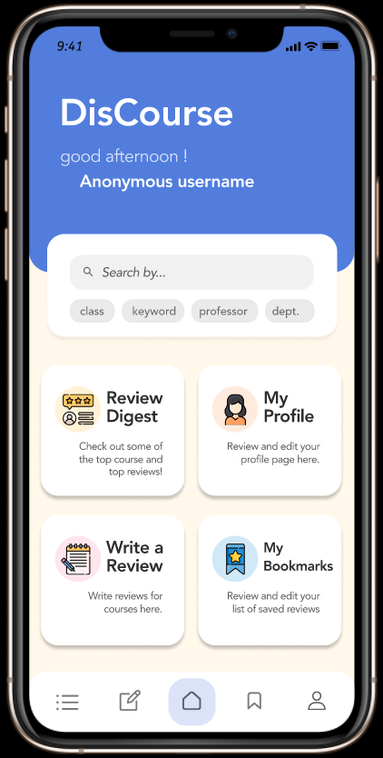
Insight from Cognitive Walkthrough
Notes:
(35 seconds)
So in our low-fidelity prototype, we originally directed the user to their profile after they finished creating it. However, during the cognitive walkthrough we realized that someone using this app would be more excited to start using the main features of the app instead of looking at the profile they just made, so we made the design change to route the user to the homepage instead, where they can directly see all the cool features and start using them.

Slide 7

Solution
Pre-Heuristic Evaluation
Flexibility and Efficiency of Use
Added a navigation bar consisting of the main areas of the app for users to easily toggle between.
Navigating between the main sections of the app required returning to the Home page before selecting the desired area.
Write a Review
My Bookmarks
Review Digest
Home
Profile

Slide 8
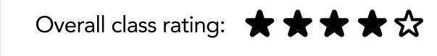
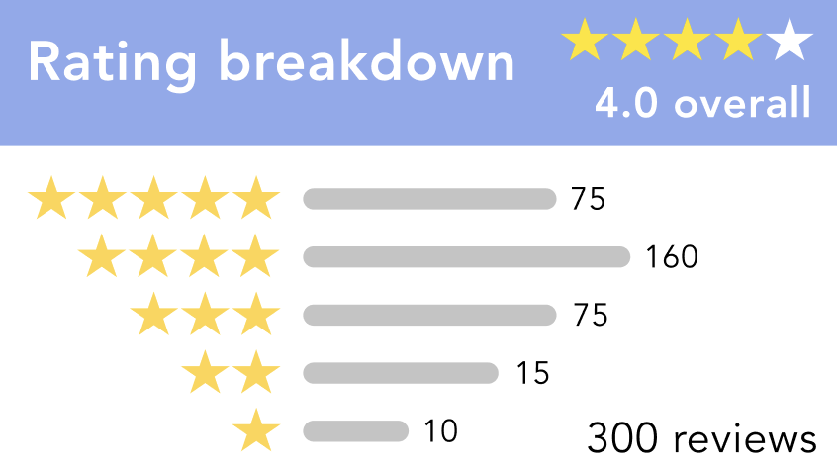
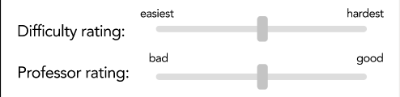
Solution
Pre-Heuristic Evaluation
Consistency & Standards
Opted for star ratings which holds consistency with how ratings are generally displayed in other interfaces.
Within review writing
Originally the interface that provided the “overall rating” when constructing a review functioned and displayed as a sliding bar.
Rating display
Sliding bar
Notes:
Another change we made was the interface that provided the course’s overall rating. Originally shown as a slider bar, like the ones for difficulty rating and professor rating, we wanted to keep to the heuristic principle, consistency and standards, by rating our courses with the standard way of reviewing, with stars, as done in almost all other review platforms.

Slide 9
Thanks for listening!
Notes:
So that’s all we have for you today, and thanks for listening!

Slide 10
—SOMEONE FAMOUS
“This is a quote, words full of wisdom that someone important said and can make the reader get inspired.”

Slide 11
AWESOME WORDS

Slide 12
OVERVIEW
MERCURY
NEPTUNE
JUPITER
VENUS
It is the farthest planet from the Sun
It is the biggest planet in the Solar System
Venus has a beautiful name, but it is hot

Slide 13
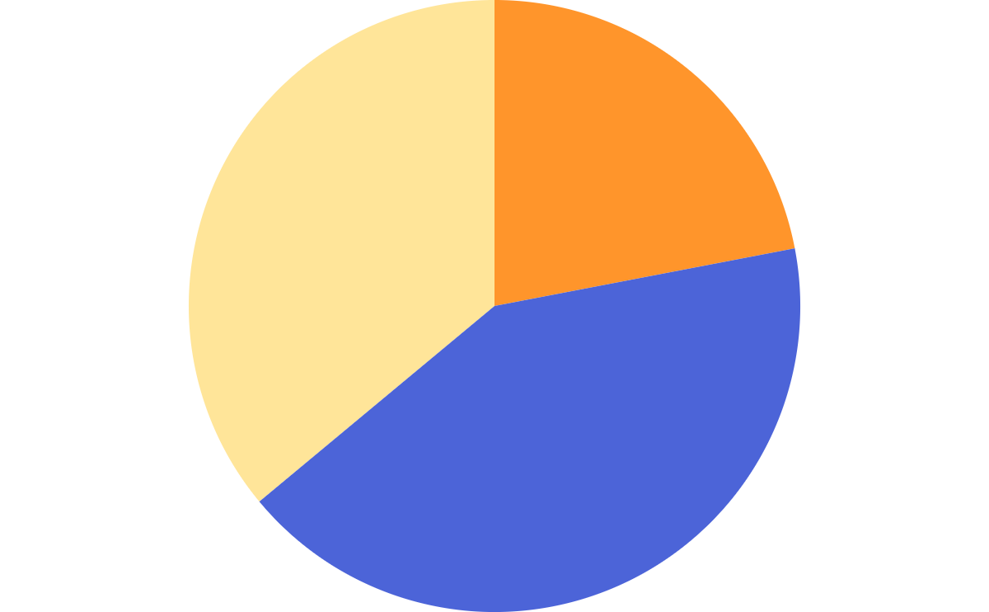
THIS IS A GRAPH
NEPTUNE
45%
Neptune is the farthest planet from the Sun
15%
VENUS
Venus has a beautiful name, but it’s hot
40%
MERCURY
Mercury is the closest planet to the Sun
To modify this graph, click on it, follow the link, change the data and paste the new graph here

Slide 14
ASSIGNMENT
 | VENUS | SATURN | EARTH
MASS | 0.08 | 2.50 | 1.15
DIAMETER | 5.95 | 9.82 | 1.05
GRAVITY | 1.02 | 2.08 | 1.13

Slide 15


A PICTURE IS A WORTH A THOUSAND WORDS

Slide 16
13,012,400
Big numbers catch your audience’s attention

Slide 17
WHAT IS THIS TOPIC ABOUT?
JUPITER
NEPTUNE
Jupiter is a gas giant and the biggest planet
Neptune is the farthest planet from the Sun
VENUS
MARS
Venus has a beautiful name, but it is hot
Despite being red, Mars is actually a cold place

Slide 18
EDUCATION ICONS PACK

Slide 19
ALTERNATIVE RESOURCES

Slide 20
RESOURCES
Did you like the resources on this template? Get them for free at our other websites.
Photos
Globe and books near laptop
Kids and teacher posing while wearing a medical mask
Happy teenager making notes near laptop
Vectors
Online certification with laptop
Online certification concept
Online certification concept
Online certification for college graduates
Icons
Education Icon Pack

